Slide 1

Wave 5
Launching the next wave in higher education
Michael M. Crow
SXSW.edu
March 7, 2016

Slide 2

Bachelor’s Degree Production and Real Gross Domestic Product
@ nation
2005 Dollars. For more see US Department of the Treasury. "The Economics of Higher Education." (2012).

Slide 3
Percent Change in Bachelor’s Degree Production and Real Gross Domestic Product Relative to 1869
Bachelor’s
Degrees
Awarded
Real GDP
For more see: US Department of the Treasury. "The Economics of Higher Education." (2012)

Slide 4
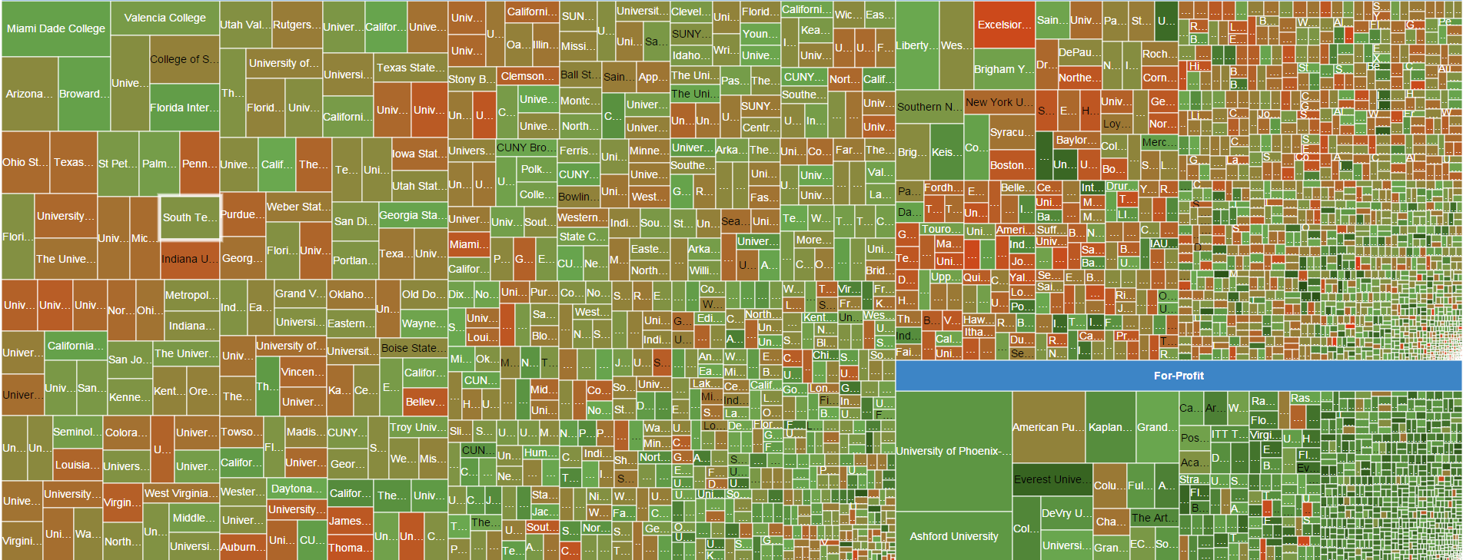
Undergraduate Enrollment by Sector, Institution and Pell Intensity
Public Universities
Private Universities
For-Profit Universities
2014 undergraduate enrollment = 13,163,399

Slide 5
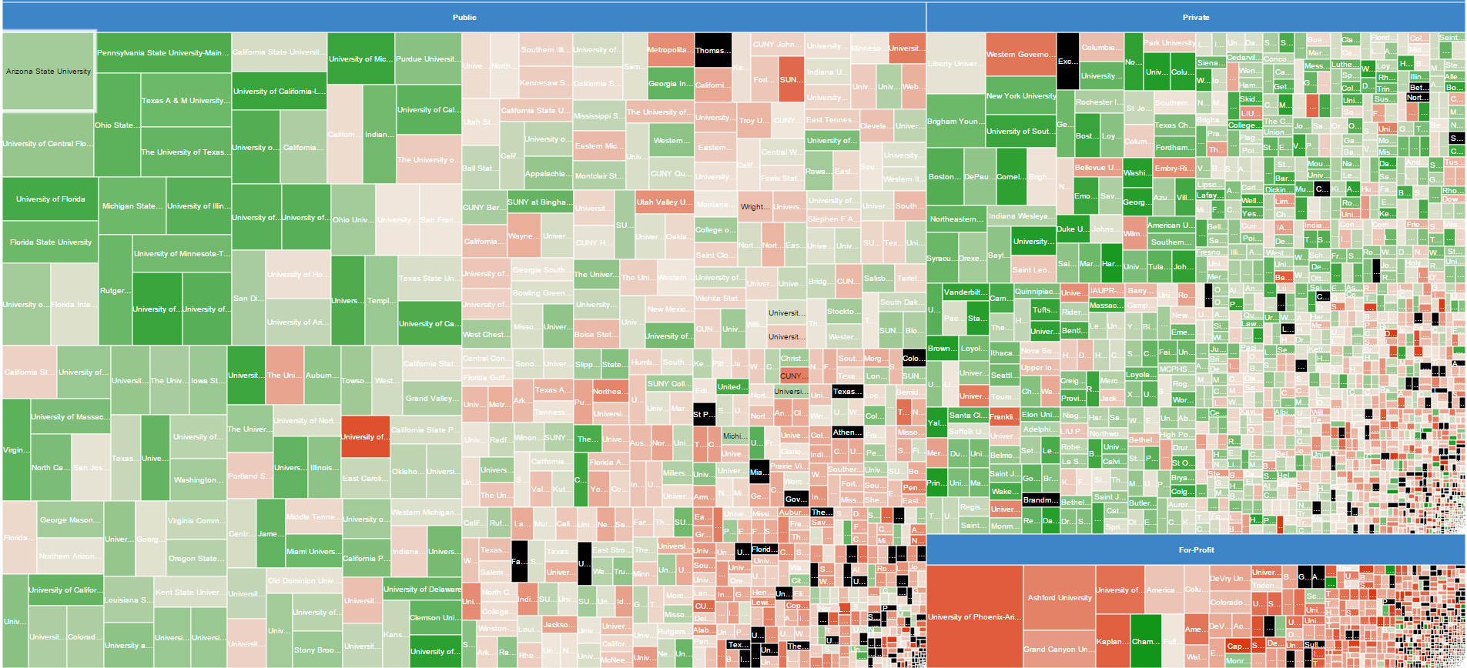
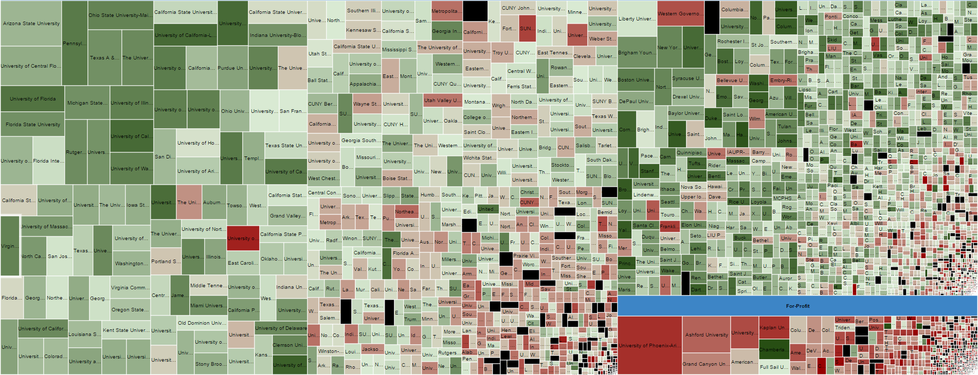
Bachelor’s Degree Production by Sector, Institution and Graduation Rate
Public Universities
Private Universities
For-Profit Universities
For-Profit Universities
2014 bachelor’s degree production = 1,892,741

Slide 6

The Imperative of Innovation

Slide 7

The Imperative of Innovation

Slide 8

The Imperative of Innovation

Slide 9
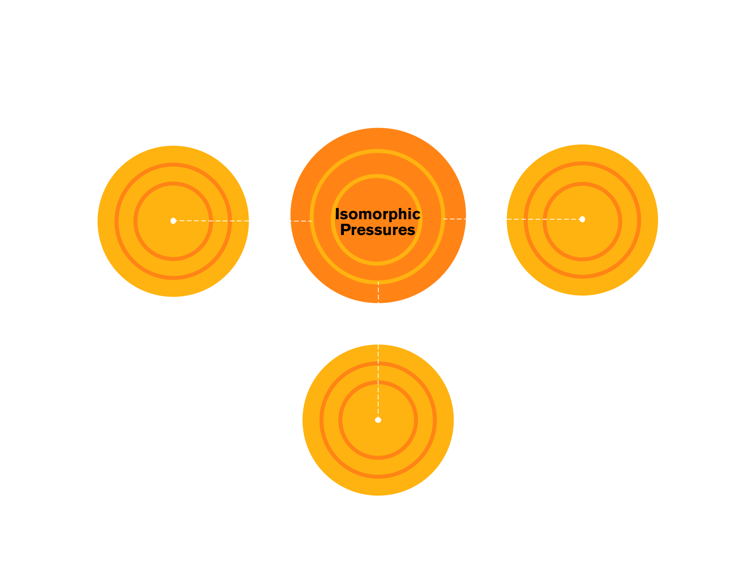
What is preventing new models?

Slide 10
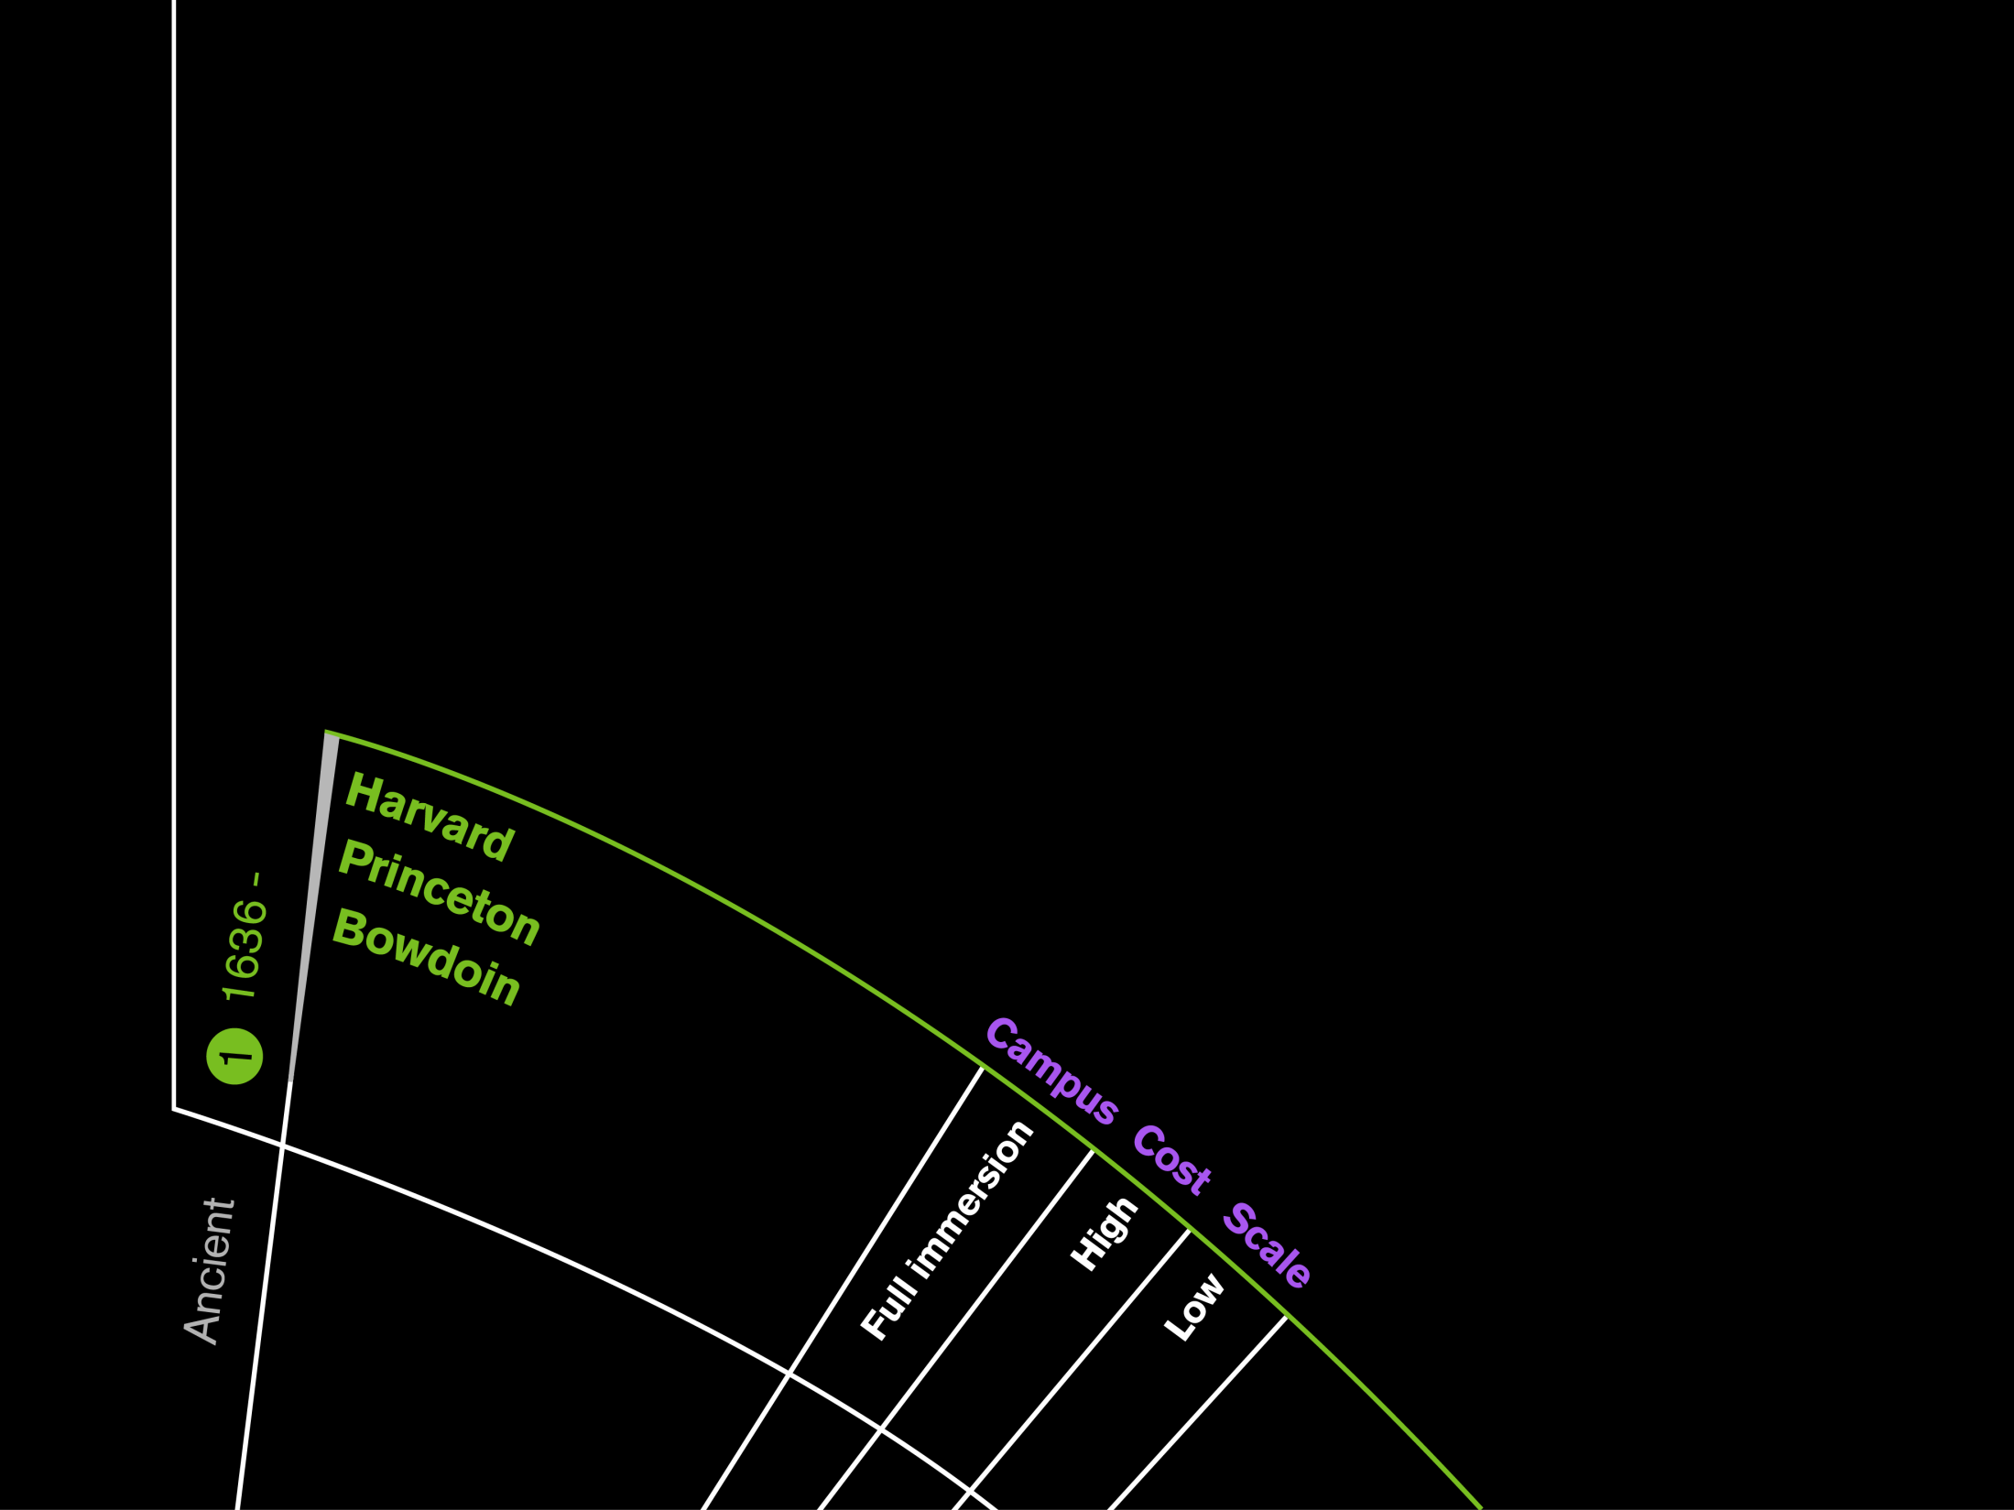

Slide 11
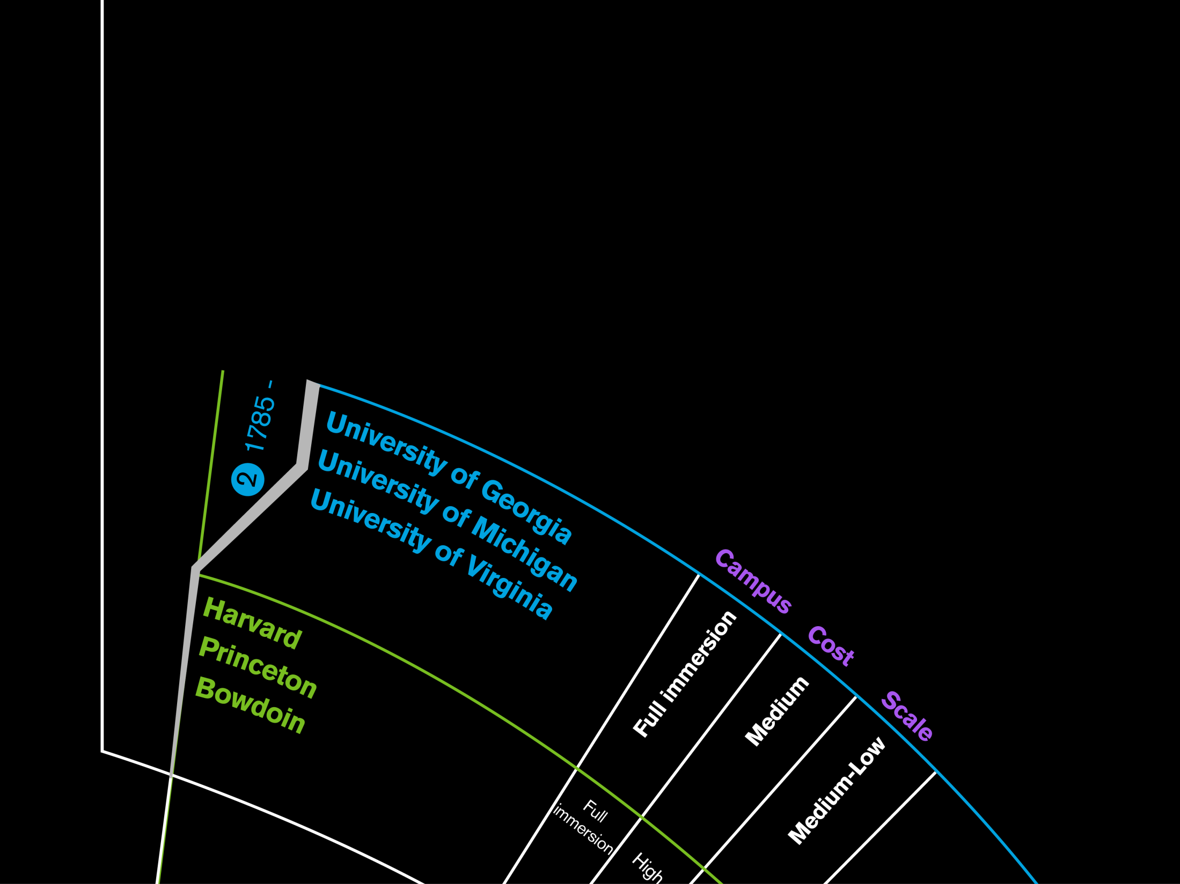

Slide 12
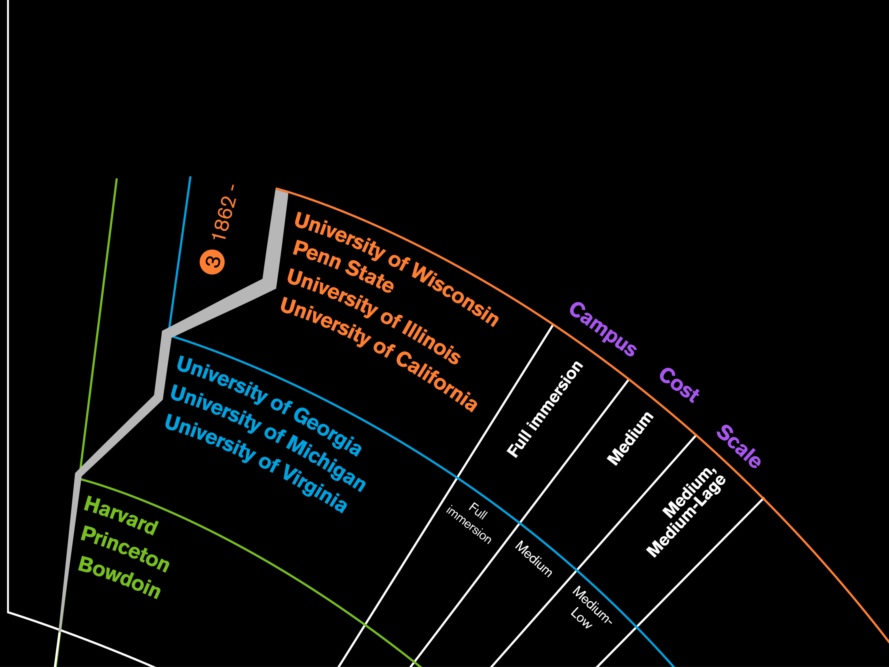

Slide 13
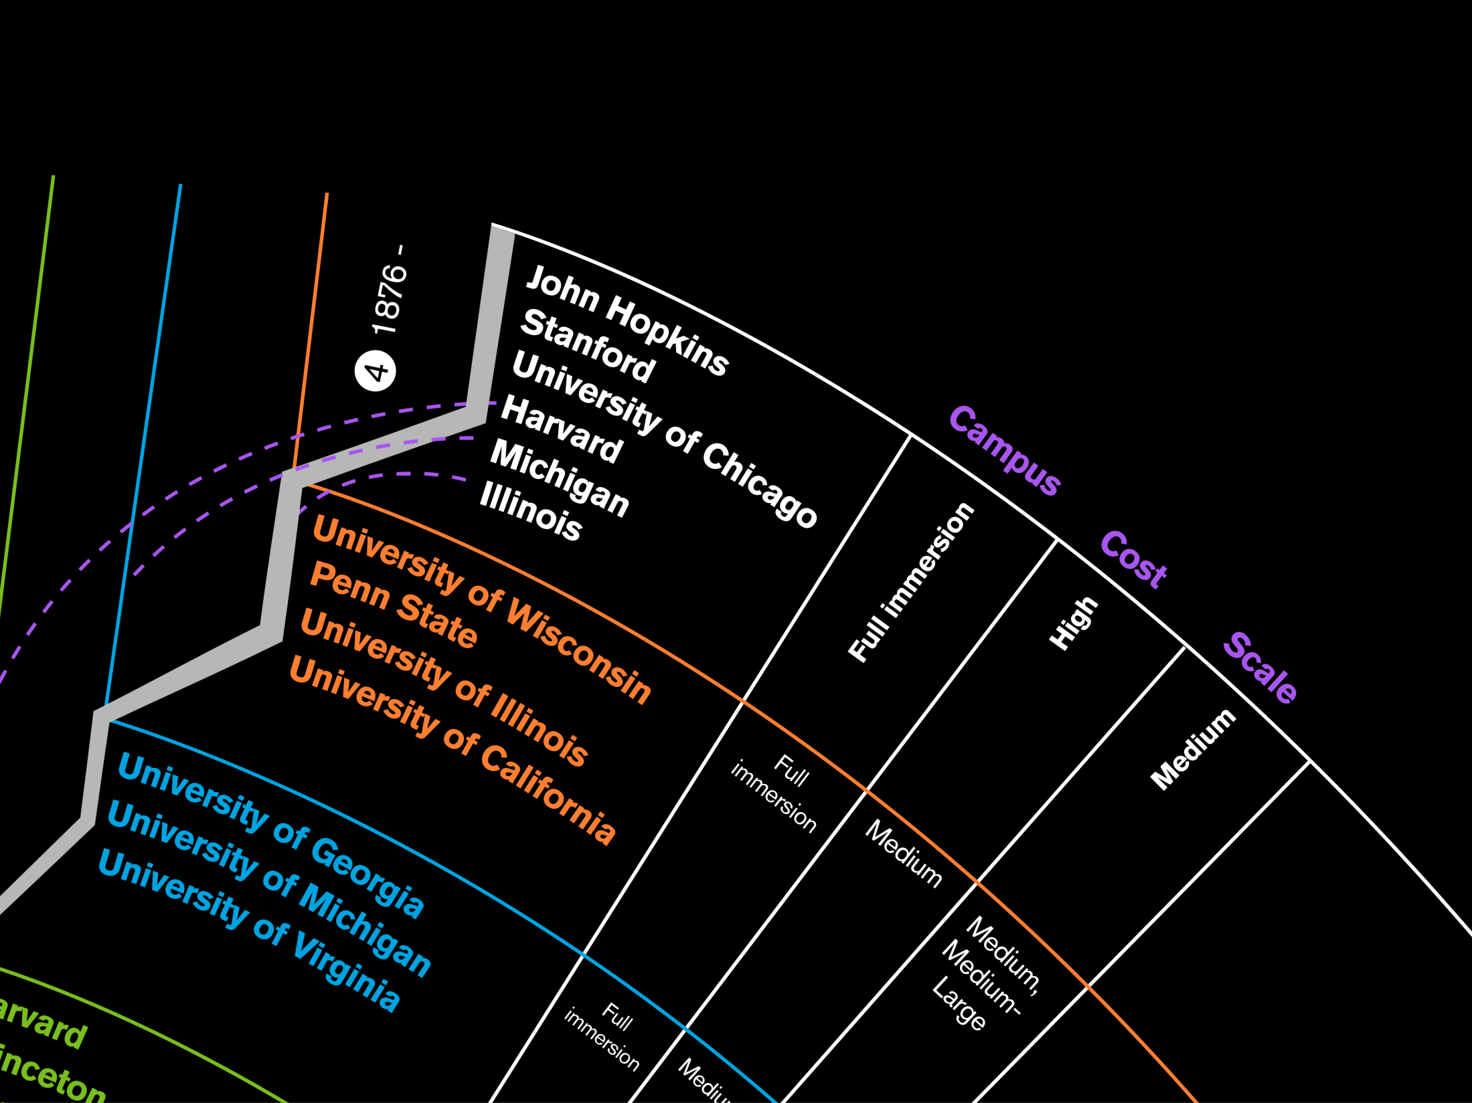

Slide 14
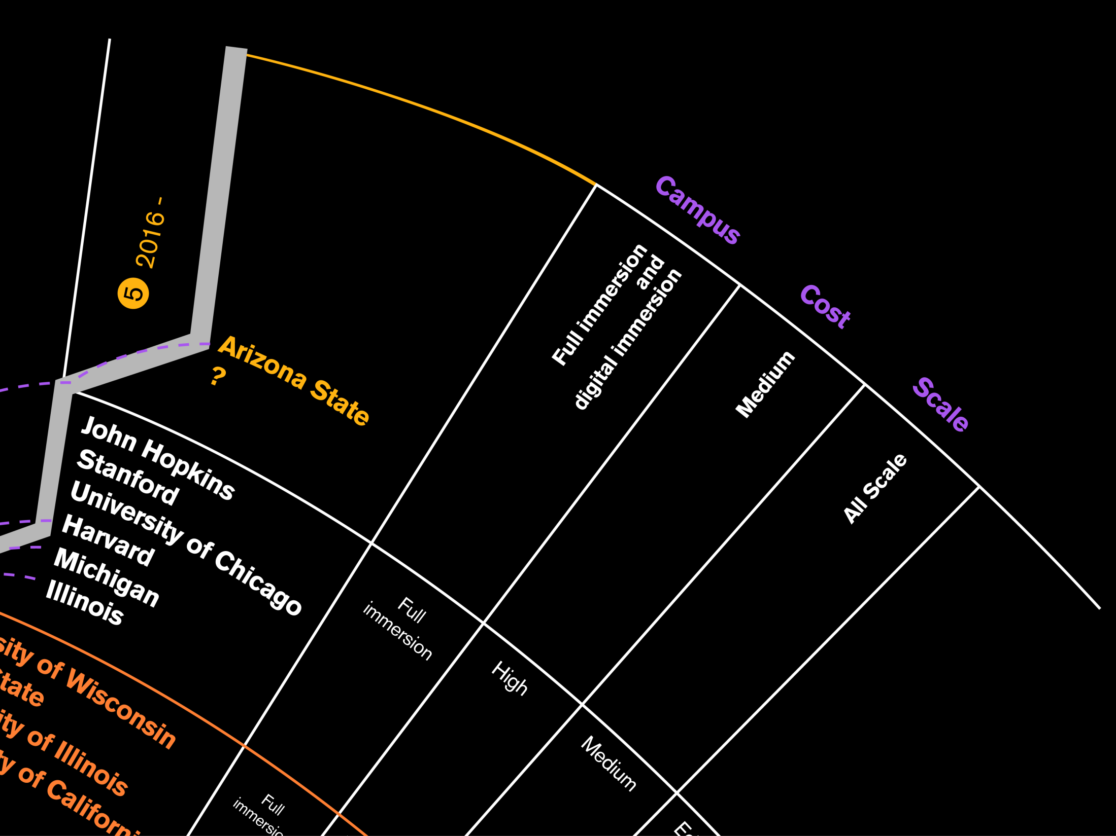

Slide 15
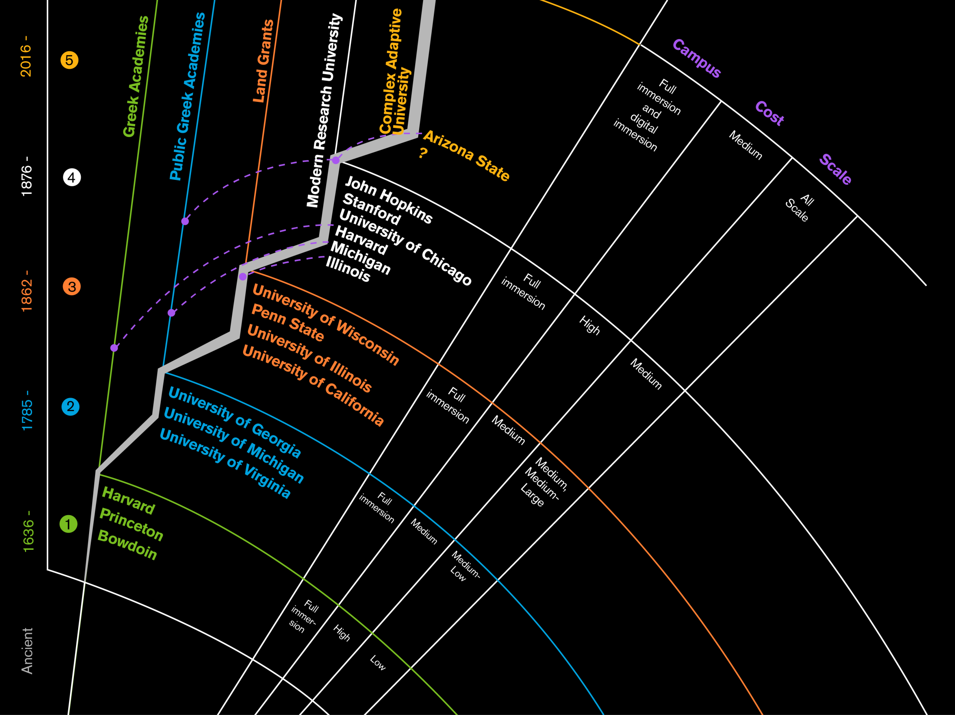

Slide 16

Teaching and Learning Realms for Wave 5

Slide 17

Teaching and Learning Realms for Wave 5

Slide 18
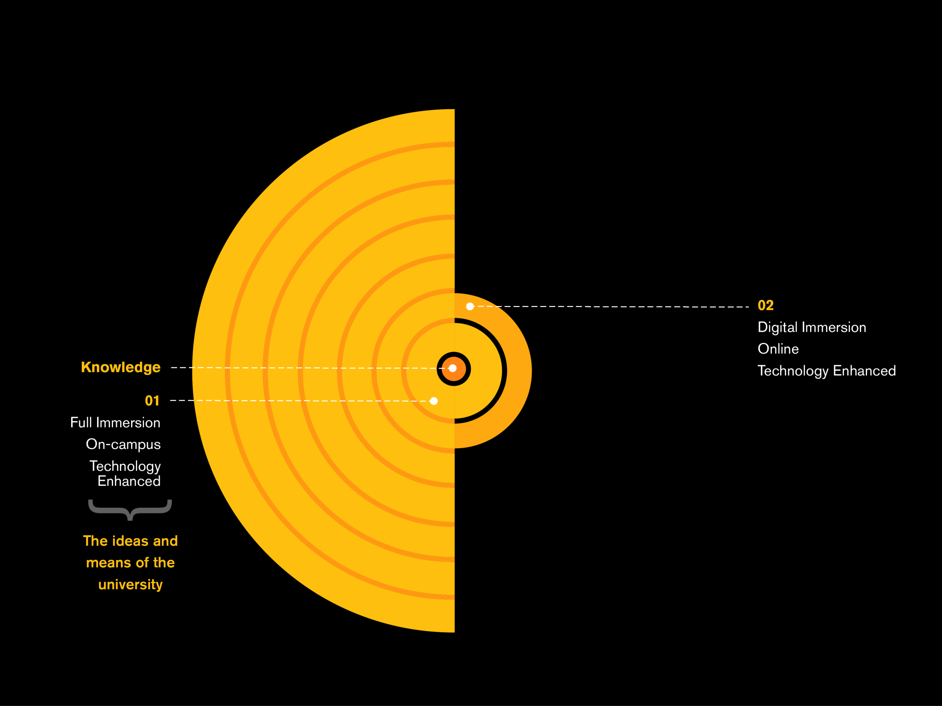
Teaching and Learning Realms for Wave 5

Slide 19
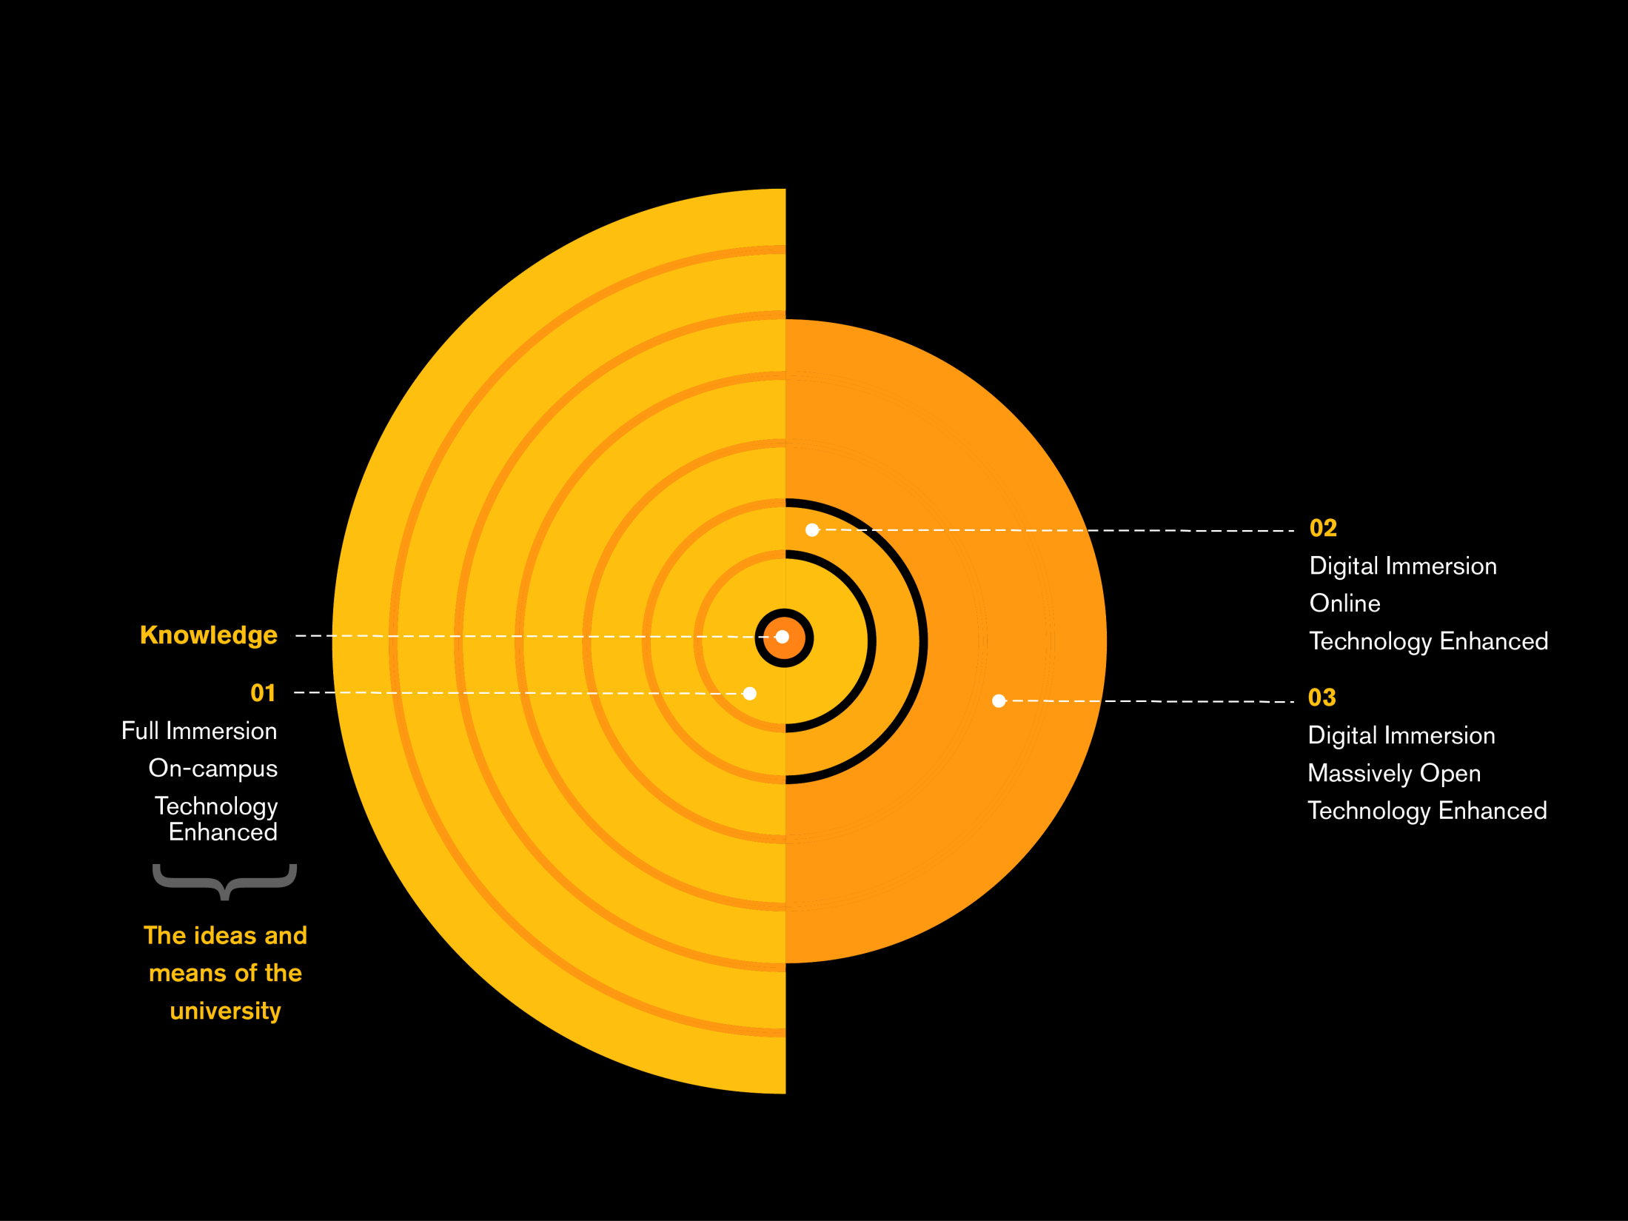
Teaching and Learning Realms for Wave 5

Slide 20
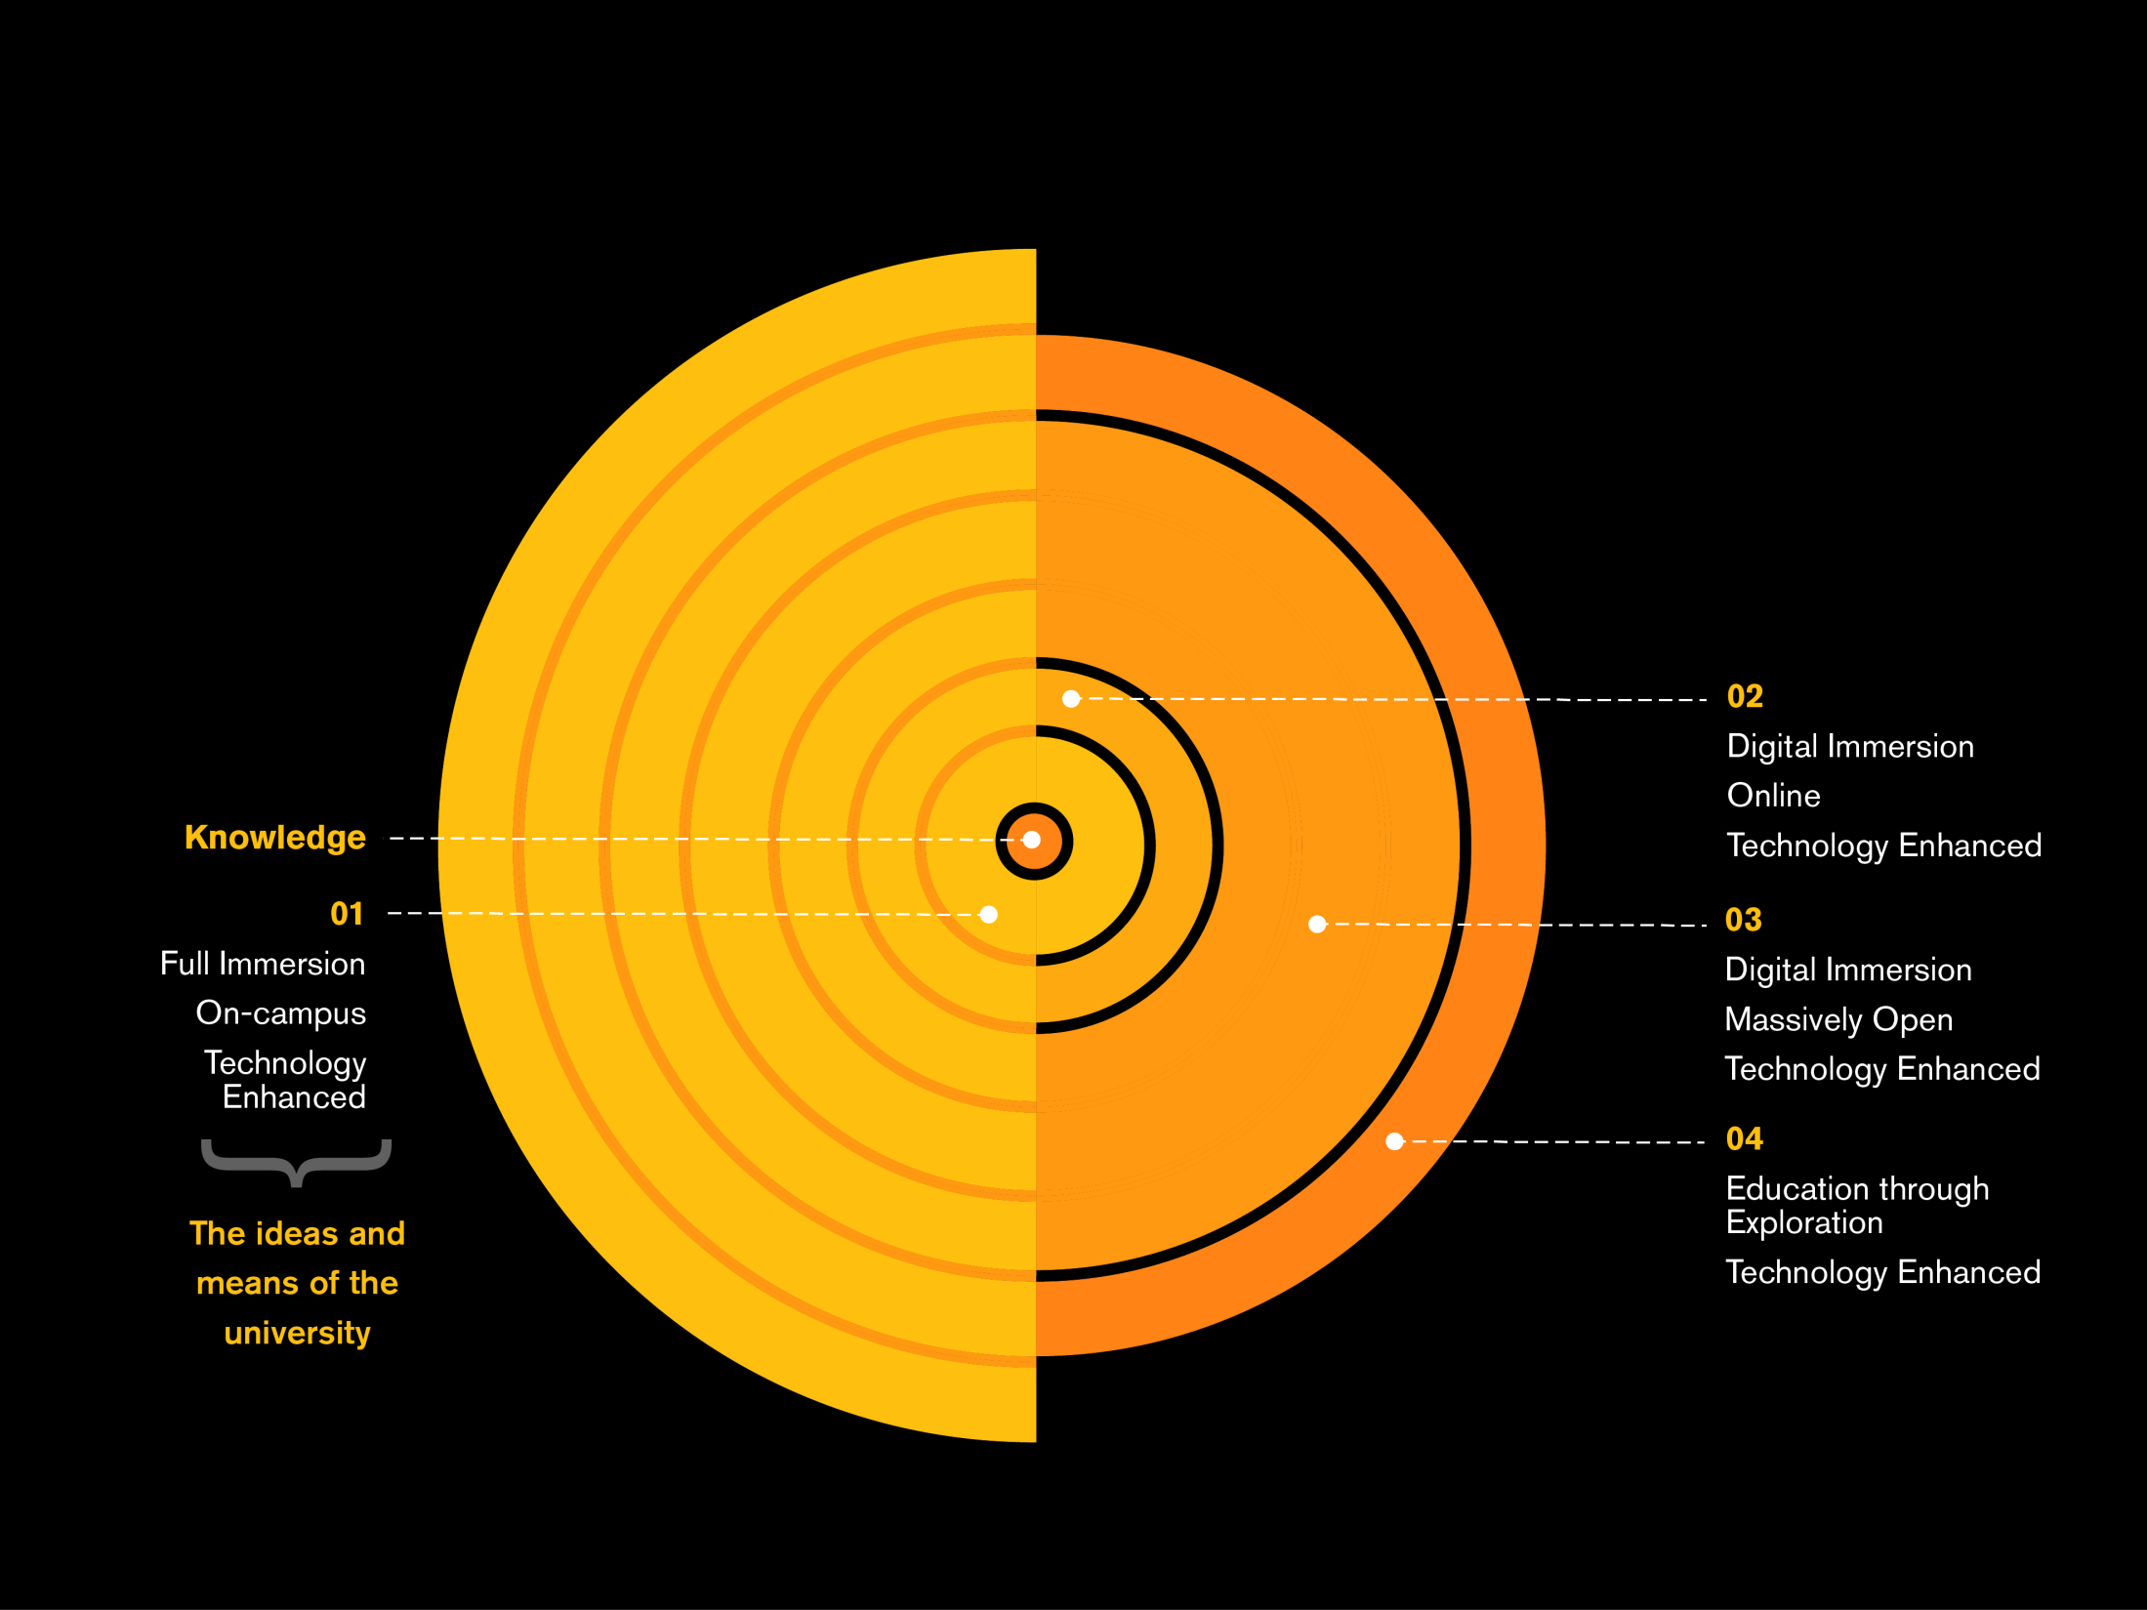
Teaching and Learning Realms for Wave 5

Slide 21
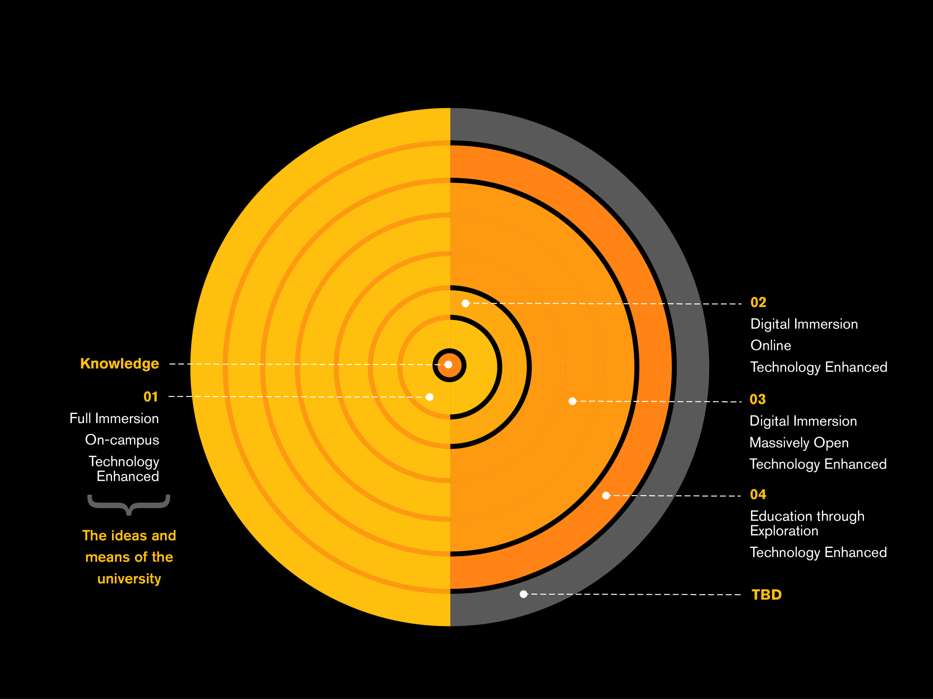
Teaching and Learning Realms for Wave 5

Slide 22
The Imperative of Innovation

Slide 23


